Slide 1
Linux Administration
Week 6 & 7
Firewalls

Slide 2
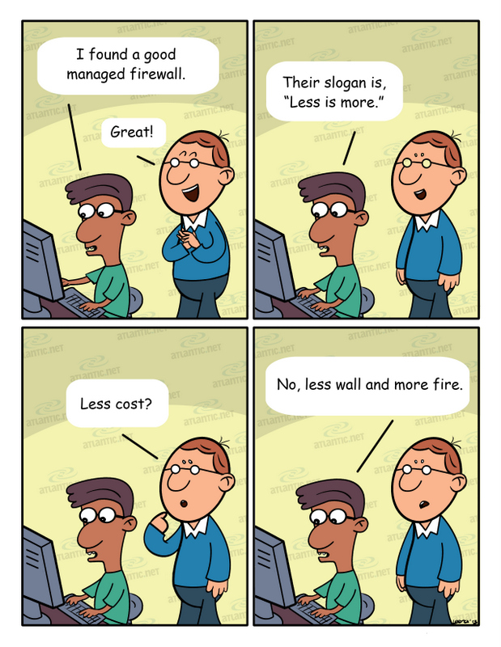
Firewalls
First line of defense

Slide 3
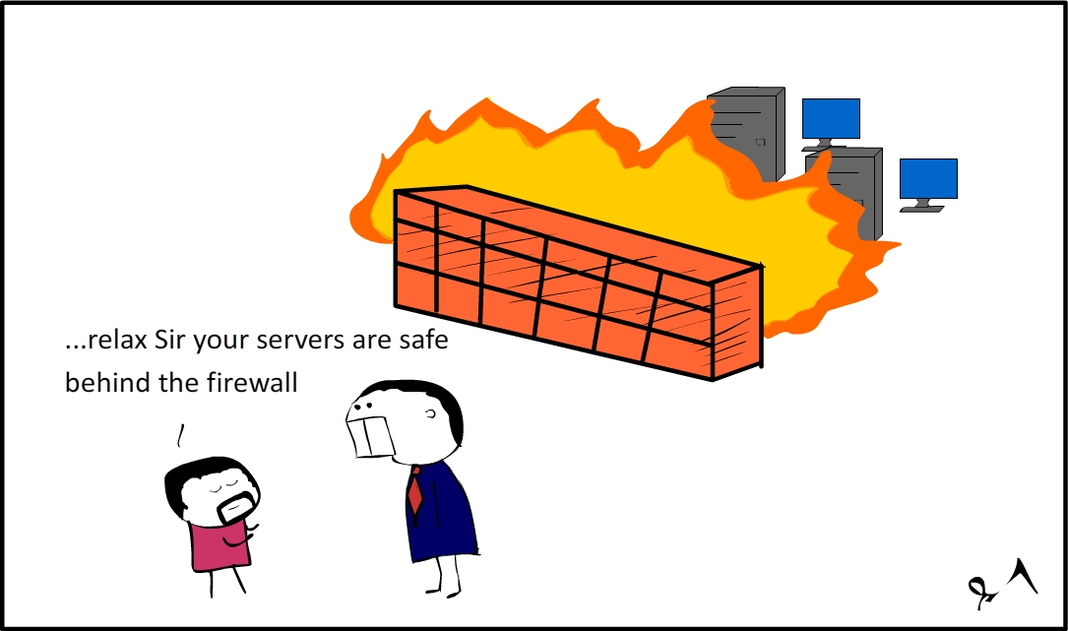
Firewalls
Examine packets
Both in and out of the network
Can determine if the packet is allowed, denied or redirected
Can check IP address, Mac address, port, or application
Deep packet analysis for data with the packets
The deeper you look the longer it takes (Bottlenecks)

Slide 4
Basic level of firewall
Deny all or allow all
What happens to packets that don’t fit a rule
Goes down list until it finds rule that it fits. Or will be allowed or denies based on deny all/allow all
Deny all is safer but takes more work
Allow all has dangers but is easy to manage
Otherwise you have to allow each thing individually, allow all has less maintenance

Slide 5
Basic firewalls cont.
IP/MAC are the easiest/quickest to filter; data is the slowest
Filter by port if the port shouldn't be used by that server
DNS server doesn't need ports for web or email
Pings are good for testing connections
allow nmap type attacks (ICMP)
Typical of situations where you want to easily allow/deny packets

Slide 6
Stateful vs stateless Firewalls
Stateless firewalls work on static information
Example: source and destination
Packet filtering is done with matching conditions
These conditions are pre-approved with corresponding pre-approved actions
Also known as an access control list
Mainly focuses on packet filtering
Typically faster
Stateful firewalls filter based on full context
Iptables are stateful
(technically so is Windows firewall, we just don't care about that right now. Linux rulz! windows drools)
Once the certain traffic is approved it's added to the state table and get more access to the protected network
If it wasn't approved it gets blocked
Can use IPSec (IP security) such as tunnels and encryption
Better at IDing unauthorized and forged info

Slide 7
Example: DDOS
During a DDOS you might filter the top 10 IP address or ranges
You could also filter a range of addresses
Example: CIS server
We filter from China and Columbia
It's unlikely we'd have legitimate access outside the US
This filters out script kiddies not the good hackers
Good hackers can get around IP address filtering

Slide 8
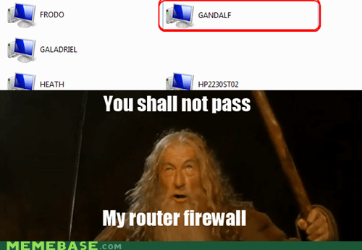
Activity
In small groups, work on what you think should happen for a DDOS event for your server. Make a list of priorities and spec them out like you're creating a script

Slide 9
Implementation in Linux
Multiple systems used for firewalls
Some built in
Some are 3rd party
IPtables are the most common
You might also see nftables, firewalld and UFW (uncomplicated Firewall Ubuntu)
IPtables don't survive a reboot
Some have ways to preserve the IPtable rules
Some have scripts you need to work with

Slide 10


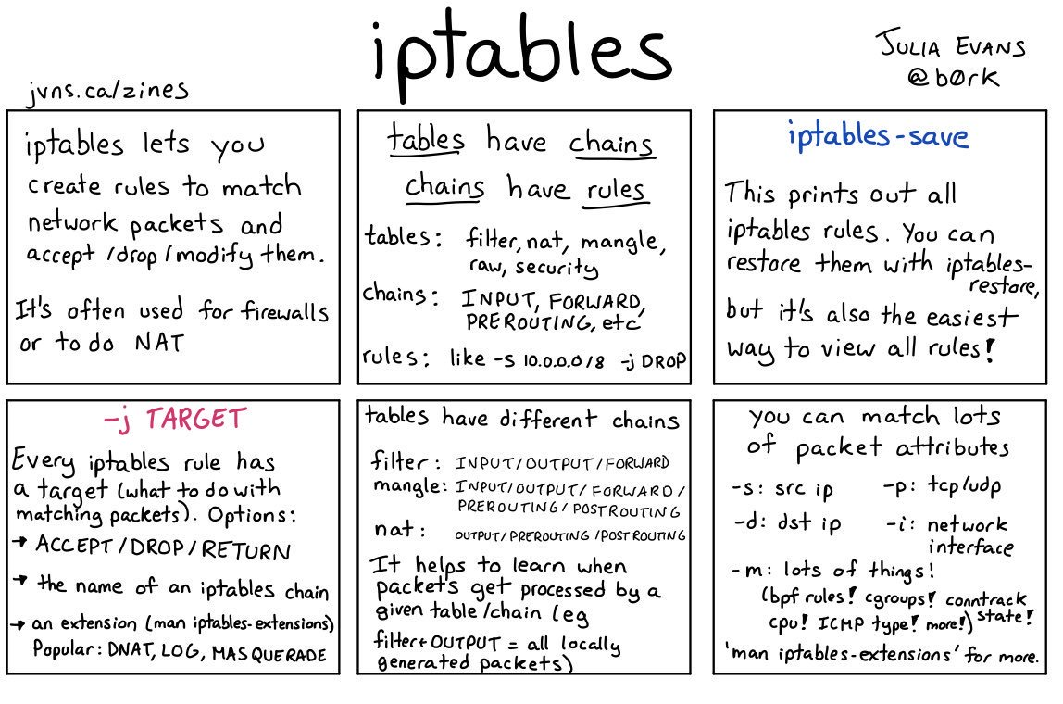



https://twitter.com/b0rk/status/1054056111626686465

Slide 11
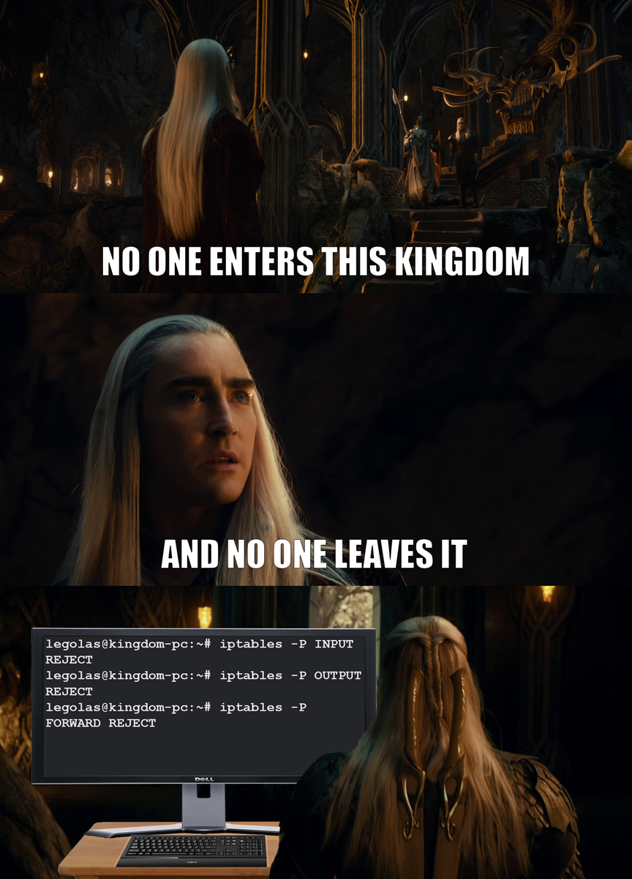
Activity
Everyone find your Iptables in CentOS
List all your rules
Block IP addresses 59.45.175.0/24
Delete the rule blocking 59.45.175.0/24
List IPv6 rules

Slide 12
Firewalls rules
Rules are done in a chain format
Order matters
As rules are examined, if a rule is used the system performs the operation and no further rules are used
Allow all or deny all is the last rule in the chain
Can accept, drop or reject packets
Drop denies without notification
Reject sends back error
Set a script for base rules and to modify rules
In case of hacking
IPv6 is similar to IPv4 but uses separate files and commands.

Slide 13
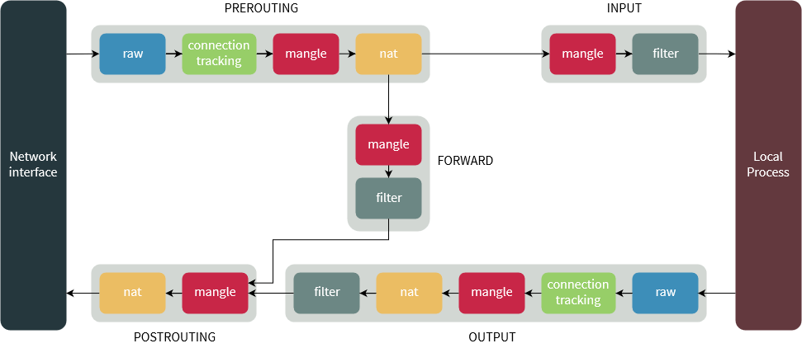
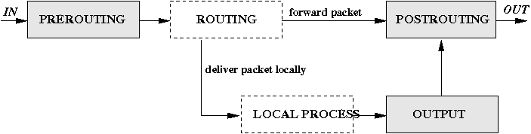
Firewall chain rules
Separate chains
Prerouting
Just as packets arrive
Nat, mangle and raw
Input
Before poackets are given to local process
Mange and filter
Output (postrouting)
Packets after they are produced by a process
Raw, mangle, nat and filter
Forwarding (mostly routers)
Packets routed through current host
Mangle and Filter
Postrouting
Packets as they leave
Nat and mangle

Slide 14
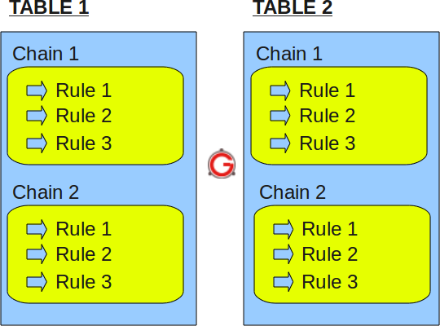
Example: How to work with IPTables
Add basic rule
iptables -A INPUT -s 10.10.10.10 -j DROP
adds to the input chain, drops by IP (10.10.10.10 )
You can list (iptables -L) or flush (iptables -F rules)

Slide 15
Activity
Activity 1 : In Groups write a script to show IPtables rules, IP6tables rules, add some headings and titles so it's clear what you're looking at.
Activity 2 : Write a script to shut down everyone on the system except you (Alternative to full shutdown)

Slide 16
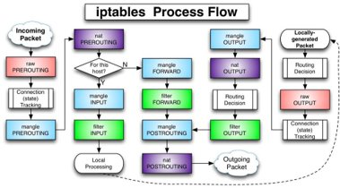
More in depth on tables
Filter table
Main table people use, Used to decide if you allow a packet or deny access.
NAT table
Used for network address translation rules. Commonly used to route packets to networks when direct access isn't possible
Mangle Table
Used to alter IP addresses of packets
For instance, you can adjust the TTL (Time to Live) value of a packet, either lengthening or shortening the number of valid network hops the packet can sustain.
Security Table
Used to set internal SELinux security context marks on packets,
Raw table
Only purpose is to provide a mechanism for marking packets in order to opt-out of connection tracking

Slide 17
DMZ
Demilitarized zone
Where the problem children live
Web
Email
VoIP
FTP
Forwarding sends packets to the DMZ

Slide 18
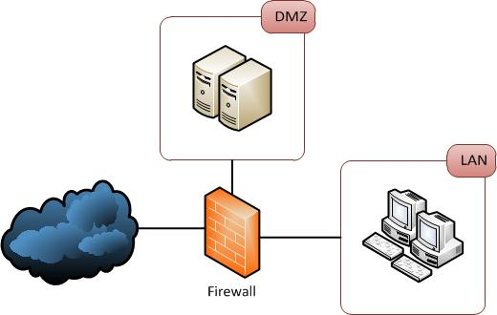
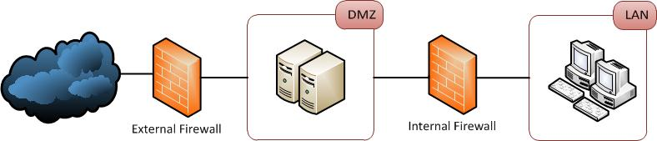
Dual Firewalls
Can also use a dual firewall
First one is the front end, configured to allow DMZ traffic only
Second firewall is back end, only allows traffic to DMZ from internal
Multiple firewalls is common in industry. Normally you use separate vendors as well

